Slide 1
Prepay cancel process

Slide 2
작업 범위
* 가상 계좌 취소 처리 필요에 따른 프로세스 정립
* 가상 계좌 취소 처리 시 내/외부 노출 상태값을 명확하게 정리
* 가상 계좌 외 신용카드 취소 처리의 상태값도 같이 정리
* 신용카드 및 가상 계좌 취소 요청시 안내 팝업(언제쯤 취소 될 것 이다) 라는 내용 노출
작업 내용
순번 | 항목 | 내용 | 비고
1 | 가상계좌 취소 프로세스 | 가상계좌 취소 / 환불 관련 프로세스 작업 | 신규
2 | 상태값 추가 | Cancel Confirmed 상태값 추가 | 신규
3 | 신용카드 프로세스 변경 | 신용 카드 취소 프로세스 일부 변경(고객 상태값 노출 부분) | 변경
4 | 취소 팝업 추가 | 사용자 영역 취소 팝업 추가 | 신규

Slide 3
Scope of Work
* Establish process due to the need for virtual account cancellation processing
* Clearly define internal/external exposure status values when processing virtual account cancellations
* Also organize the status values for credit card cancellation processing, in addition to virtual accounts
* Display a notification pop-up (indicating when the cancellation will be processed) when credit card and
virtual account cancellations are requested
작업 내용
No. | Item | Description | Remarks
1 | Virtual Account Cancellation Process | Work on virtual account cancellation / refund related processes | New
2 | Add Status Value | Add "Cancel Confirmed" status value | New
3 | Credit Card Process Change | Partial change to credit card cancellation process (customer status exposure part) | Changed
4 | Add Cancellation Pop-up | Add cancellation pop-up in user area | New

Slide 4
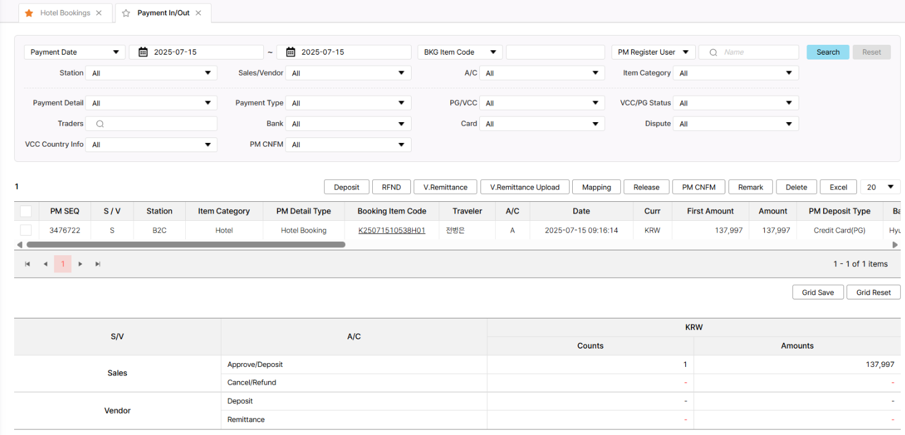
Prepay cancel process
김 학성
Prepay
RFND Button
공통안내 항목
□ DESCRIPTION □
1 | RFND - 해당 기능을 그대로 사용 - Booking Detail 에 버튼 추가
2
3
4
1

Slide 5
Prepay cancel process
김 학성
Prepay
RFND Button
공통안내 항목
□ DESCRIPTION □
1 | RFND - Use the existing function as is - Add button to Booking Detail
2
3
4
1

Slide 6
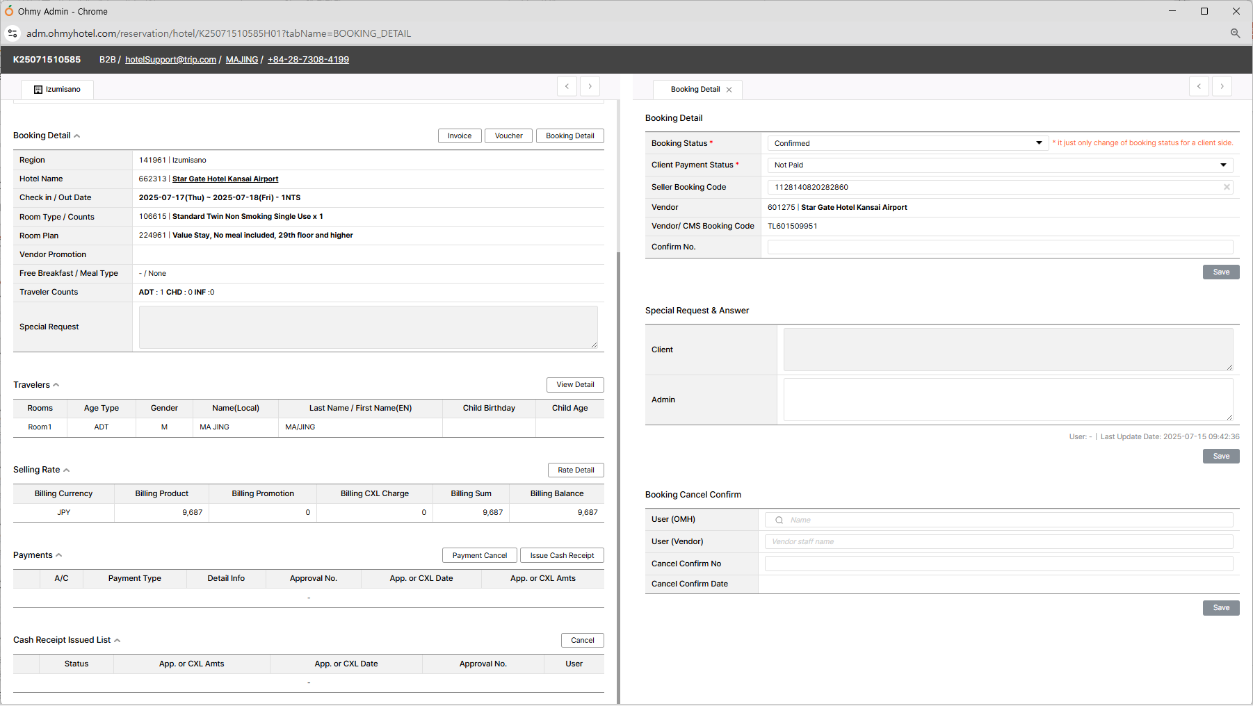
Prepay cancel process
김 학성
Hotel Booking > Booking Detail
RFND Button
공통안내 항목
□ DESCRIPTION □
1 | 1. RFND - Disabled state - Remains disabled until GBO or OP team approves cancellation - Button is activated only when cancellation is approved - Displayed only for virtual accounts
2
3
4
1
RFND

Slide 7
Prepay cancel process
김 학성
Hotel Booking > Booking Detail
RFND Button
공통안내 항목
□ DESCRIPTION □
1 | 1. RFND - 비활성화 상태 - GBO 혹은 OP 팀에서 취소 승인을 하기 전까지 비활성화 상태 - 취소 승인 상태가 되어야, 버튼이 활성화 됨 - 가상 계좌의 경우에만 노출
2
3
4
1
RFND

Slide 8
Prepay cancel process
김 학성
Hotel Booking > Booking Detail
Payment Cancel
공통안내 항목
2
취소 승인 처리 하시겠습니까?
가상계좌의 환불 및 취소는 승인 후 회계팀 처리 시 완료됩니다.
□ DESCRIPTION □
1 | 1. Payment Cancel - 클릭시 경고창 생성 - 가상계좌와 카드의 기능이 다름 - 가상계좌의 경우 [취소 승인]의 개념 - 실제 취소 및 환불은 RFND 버튼으로 처리
2 | 2. 컨팜창 - 취소 승인 컨펌창 - [예] 선택시 취소 승인 - [아니오] 선택시 창 닫힘
3
4
예
아니오
RFND
1

Slide 9
Prepay cancel process
김 학성
Hotel Booking > Booking Detail
Payment Cancel
공통안내 항목
2
Would you like to process the cancellation approval?
Refunds and cancellations for virtual accounts are completed upon processing by the accounting team after approval.
□ DESCRIPTION □
1 | 1. Payment Cancel - Upon Click: A warning pop-up is generated. - Functionality Difference: Virtual accounts and cards have different functions. - Virtual Accounts: In the case of virtual accounts, it's a concept of "[Cancellation Approval]". - Actual Cancellation & Refund: Processed with the RFND button.
2 | 2. Confirmation Pop-up - Purpose: Cancellation approval confirmation pop-up. - "Yes" Selection: Leads to cancellation approval. - "No" Selection: Closes the pop-up
3
4
예
아니오
RFND
1

Slide 10
Prepay cancel process
김 학성
Hotel Booking > Booking Detail
RFND Button
공통안내 항목
2
환불 및 취소 처리 하시겠습니까?
□ DESCRIPTION □
1 | 1. RFND - Changes to active status after cancellation approval is complete. - When clicked, it directly calls the RFND function previously described. - Upon cancellation processing, status values are updated and refunds are processed.
2
3
4
예
아니오
1
RFND

Slide 11
Prepay cancel process
김 학성
Hotel Booking > Booking Detail
RFND Button
공통안내 항목
2
Would you like to process the refund and cancellation?
□ DESCRIPTION □
1 | 1. RFND - Changes to active status after cancellation approval is complete. - When clicked, it directly calls the RFND function previously described. - Upon cancellation processing, status values are updated and refunds are processed.
2
3
4
예
아니오
1
RFND

Slide 12
Prepay cancel process
김 학성
Prepay
가상계좌 취소 프로세스
예약 확인
예약 취소 요청
예약 취소 접수
예약 취소 승인
예약취소 및 환불
위치
경로
처리자
버튼명
액션
상태값(내부)
상태값(고객)
F/E OMH
예약확인 > 예약 취소
User
-
예약 취소를 하기 위해 이동
Confirmed
Confirmed
F/E OMH
예약확인 > 예약 취소
User
예약취소
예약 취소를 요청
Cancel Request
Cancel Request
B/E Adm
Hotel Bookings > Booking detail
GBO / OP Team
-
예약 취소 접수 확인
Cancel Request
Cancel Request
B/E Adm
Hotel Bookings > Booking detail
GBO / OP Team
Payment Cancel
예약 취소 승인
Cancel Confirmed
Cancel Request
B/E Adm
Hotel Bookings > Booking detail
Account Part
RFND
환불 처리 및 예약 취소 상태값 변경
Cancelled
Cancelled
예약 취소 접수
예약 취소 진행
예약 취소 승인
예약취소 및 환불
위치
경로
처리자
버튼명
액션
상태값(내부)
상태값(고객)
B/E Adm
Hotel Bookings > Booking detail
GBO Team
-
예약 취소 접수
Confirmed
Confirmed
B/E Adm
Hotel Bookings > Booking detail
GBO / OP Team
Cancel
예약 취소 진행
Cancel Request
Cancel Request
B/E Adm
Hotel Bookings > Booking detail
GBO / OP Team
Payment Cancel
예약 취소 승인
Cancel Confirmed
Cancel Request
B/E Adm
Hotel Bookings > Booking detail
Account Part
RFND
환불 처리 및 예약 취소 상태값 변경
Cancelled
Cancelled

Slide 13
Prepay cancel process
김 학성
Prepay
Virtual Account Cancellation Process
Booking Confirmation
Booking Cancellation Request
Booking Cancellation Received
Booking Cancellation Approved
Booking Cancellation and Refund
Loc
Path
Proc
Btn
Act
Int. Status
Cust. Status
F/E OMH
Booking Confirmation > Booking Cancellation
User
-
Navigate to cancel booking
Confirmed
Confirmed
F/E OMH
Booking Confirmation > Booking Cancellation
User
Cancel Booking
Request Booking Cancellation
Cancel Request
Cancel Request
B/E Adm
Hotel Bookings > Booking detail
GBO / OP Team
-
Confirm Booking Cancellation Receipt
Cancel Request
Cancel Request
B/E Adm
Hotel Bookings > Booking detail
GBO / OP Team
Payment Cancel
Booking Cancellation Approval
Cancel Confirmed
Cancel Request
B/E Adm
Hotel Bookings > Booking detail
Account Part
RFND
Refund Processing and Booking Cancellation Status Change
Cancelled
Cancelled
Booking Cancellation Received
Booking Cancellation in Progress
Booking Cancellation Approved
Booking Cancellation and Refund
Loc
Path
Proc
Btn
Act
Int. Status
Cust. Status
B/E Adm
Hotel Bookings > Booking detail
GBO Team
-
Booking Cancellation Received
Confirmed
Confirmed
B/E Adm
Hotel Bookings > Booking detail
GBO / OP Team
Cancel
Booking Cancellation in Progress
Cancel Request
Cancel Request
B/E Adm
Hotel Bookings > Booking detail
GBO / OP Team
Payment Cancel
Booking Cancellation Approval
Cancel Confirmed
Cancel Request
B/E Adm
Hotel Bookings > Booking detail
Account Part
RFND
Refund Processing and Booking Cancellation Status Change
Cancelled
Cancelled

Slide 14
Prepay cancel process
김 학성
Prepay
카드 취소 프로세스 안내
예약 확인
예약 취소 요청
예약 취소 접수
예약 취소 및 환불
위치
경로
처리자
버튼명
액션
상태값(내부)
상태값(고객)
F/E OMH
예약확인 > 예약 취소
User
-
예약 취소를 하기 위해 이동
Confirmed
Confirmed
F/E OMH
예약확인 > 예약 취소
User
예약취소
예약 취소를 요청
Cancel Request
Cancel Request
B/E Adm
Hotel Bookings > Booking detail
GBO / OP Team
-
예약 취소 접수 확인
Cancel Request
Cancel Request
B/E Adm
Hotel Bookings > Booking detail
GBO / OP Team
Payment Cancel
카드 취소 및 예약 취소 상태값 변경
Cancelled
Cancelled
현재 고객 화면에는
Cancelled로 노출됨
예약 취소 접수
예약 취소 진행
예약 취소 및 환불
위치
경로
처리자
버튼명
액션
상태값(내부)
상태값(고객)
B/E Adm
Hotel Bookings > Booking detail
GBO Team
-
예약 취소 접수
Confirmed
Confirmed
B/E Adm
Hotel Bookings > Booking detail
GBO / OP Team
Cancel
예약 취소 진행
Cancel Request
Cancel Request
B/E Adm
Hotel Bookings > Booking detail
GBO / OP Team
Payment Cancel
카드 취소 및 예약 취소 상태값 변경
Cancelled
Cancelled

Slide 15
Prepay cancel process
김 학성
Card
Credit Card Cancellation Process Guide
Booking Confirmation
Booking Cancellation Request
Booking Cancellation Received
Booking Cancellation and Refund
Loc
Path
Proc
Btn
Act
Int. Status
Cust. Status
F/E OMH
Booking Confirmation > Booking Cancellation
User
-
Navigate to cancel booking
Confirmed
Confirmed
F/E OMH
Booking Confirmation > Booking Cancellation
User
Cancel Booking
Request Booking Cancellation
Cancel Request
Cancel Request
B/E Adm
Hotel Bookings > Booking detail
GBO / OP Team
-
Confirm Booking Cancellation Receipt
Cancel Request
Cancel Request
B/E Adm
Hotel Bookings > Booking detail
Account Part
Payment Cancel
Card Cancellation and Booking Cancellation Status Change
Cancelled
Cancelled
`
Currently displayed as "Cancelled" on the customer screen
Booking Cancellation Received
Booking Cancellation in Progress
Booking Cancellation and Refund
Loc
Path
Proc
Btn
Act
Int. Status
Cust. Status
B/E Adm
Hotel Bookings > Booking detail
GBO Team
-
Booking Cancellation Received
Confirmed
Confirmed
B/E Adm
Hotel Bookings > Booking detail
GBO / OP Team
Cancel
Booking Cancellation in Progress
Cancel Request
Cancel Request
B/E Adm
Hotel Bookings > Booking detail
Account Part
Payment Cancel
Card Cancellation and Booking Cancellation Status Change
Cancelled
Cancelled

Slide 16
Prepay cancel process
김 학성
Prepay
가상계좌 취소 프로세스
Warning pop-up needed when customer clicks "cancel booking" button in CMM / GBO team is finalizing the wording
예약 확인
예약 취소 요청
예약 취소 접수
예약 취소 승인
예약취소 및 환불
Loc
Path
Proc
Btn
Act
Int. Status
Cust. Status
F/E OMH
예약확인 > 예약 취소
User
-
예약 취소를 하기 위해 이동
Confirmed
Confirmed
F/E OMH
예약확인 > 예약 취소
User
예약취소
예약 취소를 요청
Cancel Request
Cancel Request
B/E Adm
Hotel Bookings > Booking detail
GBO / OP Team
-
예약 취소 접수 확인
Cancel Request
Cancel Request
B/E Adm
Hotel Bookings > Booking detail
GBO / OP Team
Payment Cancel
예약 취소 승인
Cancel Confirmed
Cancel Request
B/E Adm
Hotel Bookings > Booking detail
Account Part
RFND
환불 처리 및 예약 취소 상태값 변경
Cancelled
Cancelled
신용카드 취소 프로세스
Warning pop-up needed when customer clicks "cancel booking" button in CMM / GBO team is finalizing the wording
예약 확인
예약 취소 요청
예약 취소 접수
예약 취소 및 환불
Loc
Path
Proc
Btn
Act
Int. Status
Cust. Status
F/E OMH
예약확인 > 예약 취소
User
-
예약 취소를 하기 위해 이동
Confirmed
Confirmed
F/E OMH
예약확인 > 예약 취소
User
예약취소
예약 취소를 요청
Cancel Request
Cancel Request
B/E Adm
Hotel Bookings > Booking detail
GBO / OP Team
-
예약 취소 접수 확인
Cancel Request
Cancel Request
B/E Adm
Hotel Bookings > Booking detail
GBO / OP Team
Payment Cancel
카드 취소 및 예약 취소 상태값 변경
Cancelled
Cancelled

Slide 17
Prepay cancel process
김 학성
Prepay
Virtual Account Cancellation Customer Pop-up Addition Location
OMH에서 고객이 예약 취소 버튼 클릭시 경고창 필요
Booking Confirmation
Booking Cancellation Request
Booking Cancellation Received
Booking Cancellation Approved
Booking Cancellation and Refund
Loc
Path
Proc
Btn
Act
Int. Status
Cust. Status
F/E OMH
Booking Confirmation > Booking Cancellation
User
-
Navigate to cancel booking
Confirmed
Confirmed
F/E OMH
Booking Confirmation > Booking Cancellation
User
Cancel Booking
Request Booking Cancellation
Cancel Request
Cancel Request
B/E Adm
Hotel Bookings > Booking detail
GBO / OP Team
-
Confirm Booking Cancellation Receipt
Cancel Request
Cancel Request
B/E Adm
Hotel Bookings > Booking detail
GBO / OP Team
Payment Cancel
Booking Cancellation Approval
Cancel Confirmed
Cancel Request
B/E Adm
Hotel Bookings > Booking detail
Account Part
RFND
Refund Processing and Booking Cancellation Status Change
Cancelled
Cancelled
Credit Card Cancellation Process Customer Pop-up Addition Location
OMH에서 고객이 예약 취소 버튼 클릭시 경고창 필요
Booking Confirmation
Booking Cancellation Request
Booking Cancellation Received
Booking Cancellation and Refund
Loc
Path
Proc
Btn
Act
Int. Status
Cust. Status
F/E OMH
Booking Confirmation > Booking Cancellation
User
-
Navigate to cancel booking
Confirmed
Confirmed
F/E OMH
Booking Confirmation > Booking Cancellation
User
Cancel Booking
Request Booking Cancellation
Cancel Request
Cancel Request
B/E Adm
Hotel Bookings > Booking detail
GBO / OP Team
-
Confirm Booking Cancellation Receipt
Cancel Request
Cancel Request
B/E Adm
Hotel Bookings > Booking detail
Account Part
Payment Cancel
Card Cancellation and Booking Cancellation Status Change
Cancelled
Cancelled
`

